Slide 1
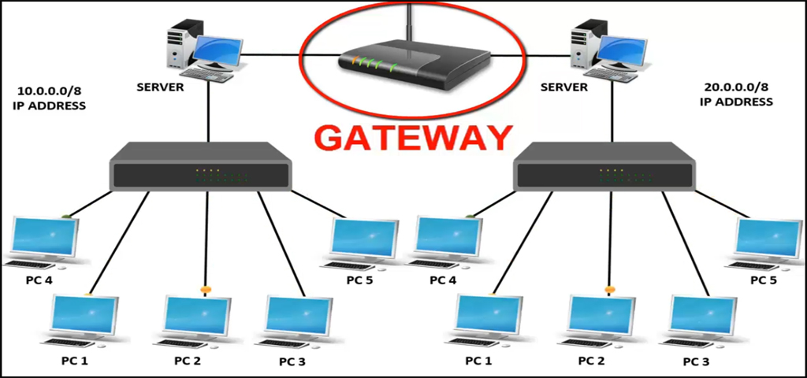
What is Computer networking?
A Computer network is defined as the interconnection of two or more computers. It is done to enable the computers to communicate and share available resources

Slide 2
What is Computer networking?
Advantage of Computer Networking
Sharing of resources such as printers.
Sharing of expensive software's and database.
Communication from one computer to another computer.
Exchange of data and information among users via network.
Sharing information over geographically wide areas.

